Slide 1
Auto prediction of traffic light timer
TEAM NEBULA

Slide 2
Problem statement
The current traffic control system (TCS) in India are inefficient due to randomness in the traffic density pattern throughout the day. The traffic signal timers have a fixed time period to switch traffic between different directions. Due to this, the vehicles have to wait for a long time span even if the traffic density is very less. If the traffic signal timer can be programmed to be manipulated with the continuously varying traffic density, the problem of traffic congestion can be reduced to a significantly lower levels.

Slide 3
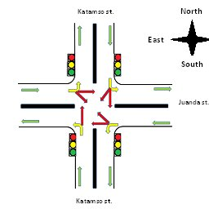
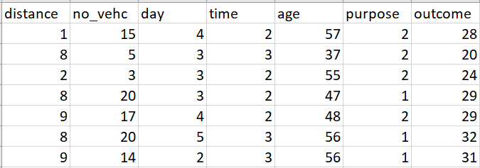

Slide 4
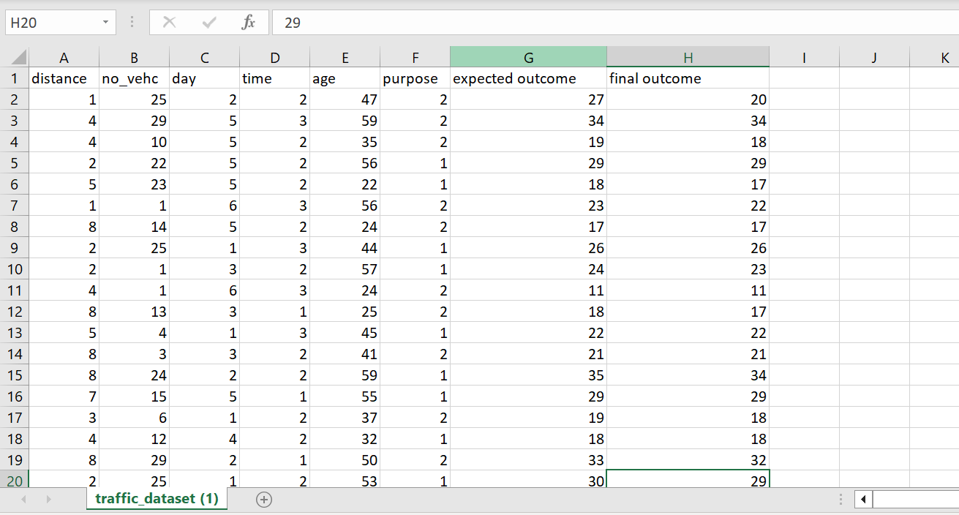

Slide 5
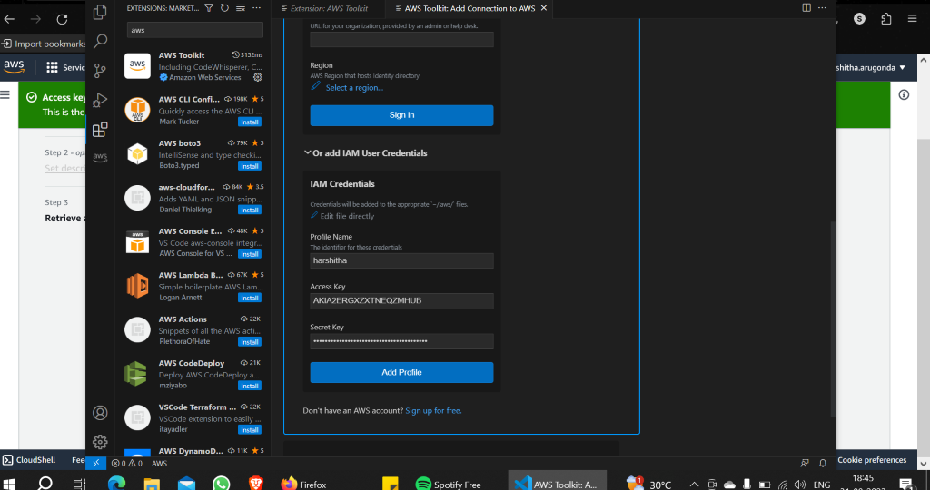

Slide 6

S3-simple storage service

Slide 7
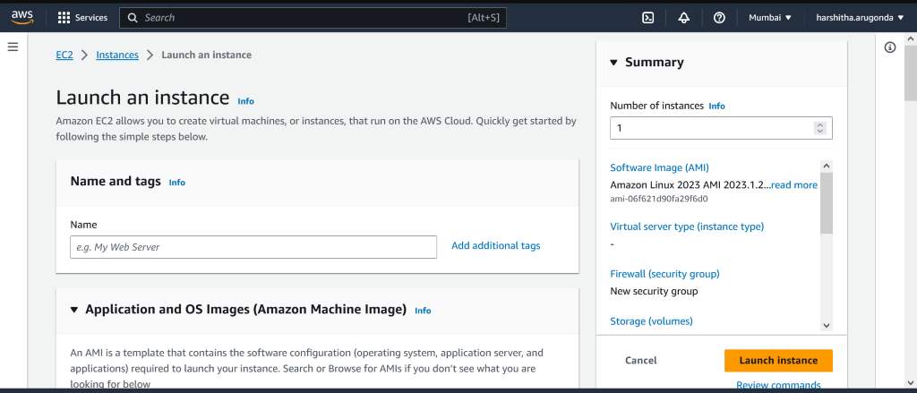
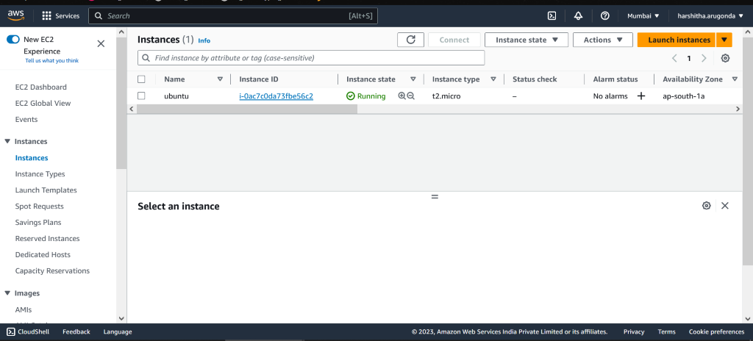

Slide 8
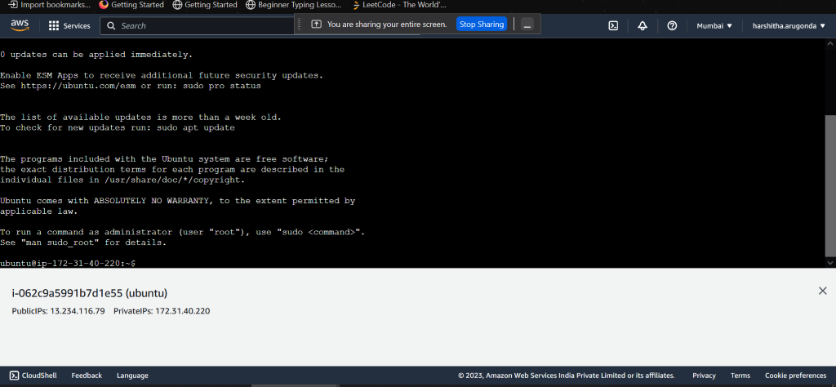

Slide 9
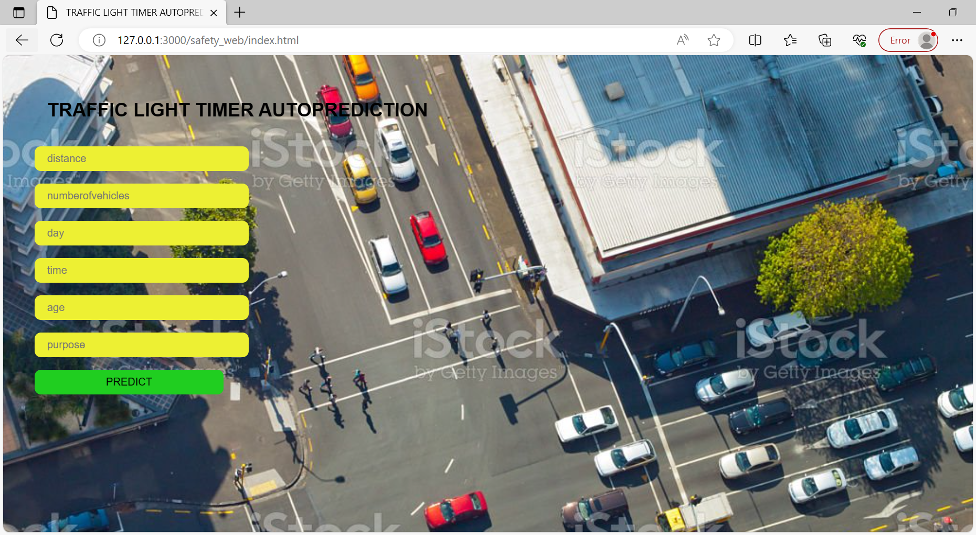

Slide 10
thank you

